Slide 1
Inequality and culture
4/14/2022
Xuewen Yan

Slide 2
What do sociologists mean by inequality?
Stratification: systematic differentiations in the possession of and access to valued resources (e.g., wealth, income, political power, status/prestige) across social groups (e.g., gender, race, neighborhood etc)
Weber: Class, Status, Party
Marx: Class
Sociologists’ classic look at inequality: class-based;
Contemporary class theories: occupational-groupings
Erickson and Goldthorpe class schema; Grusky and Weeden, micro-class;李路路：中国十大阶级

Slide 3
Social Mobility
Mobility: an individual’s change in social status from one status to another
Sociologists’ classic Social mobility = social class mobility ~~ intergenerational (social class) immobility
The tendency for kids to inherit their parents’ occupation/social status
Absolute vs relative mobility
Fluidity?
Income mobility (elasticity) vs social (class) mobility (
Equality of opportunity (meritocracy) vs equality of outcome
Ascribed status vs achieved status

Slide 4
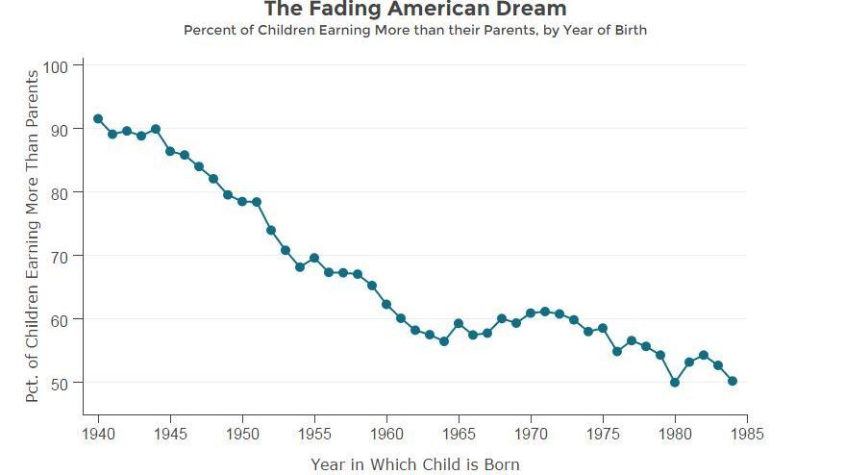

Slide 5
Chetty et al. 2014 Where is the land of opportunity?
“We use administrative records on the incomes of more than 40 million children and their parents to describe three features of intergenerational mobility in the United States.
First, we characterize the joint distribution of parent and child income at the national level. The conditional expectation of child income given parent income is linear in percentile ranks. On average, a 10 percentile increase in parent income is associated with a 3.4 percentile increase in a child’s income.
Second, intergenerational mobility varies substantially across areas within the U.S. For example, the probability that a child reaches the top quintile of the national income distribution starting from a family in the bottom quintile is 4.4% in Charlotte but 12.9% in San Jose.
Third, we explore the factors correlated with upward mobility. High mobility areas have (1) less residential segregation, (2) less income inequality, (3) better primary schools, (4) greater social capital, and (5) greater family stability. While our descriptive analysis does not identify the causal mechanisms that determine upward mobility, the publicly available statistics on intergenerational mobility developed here can facilitate research on such mechanisms.”

Slide 6
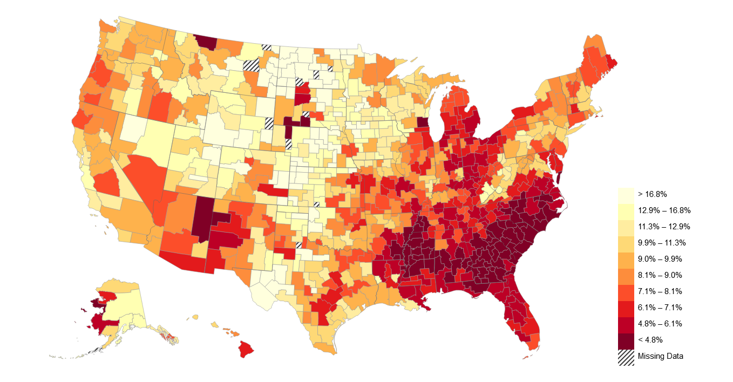
Chetty et al. 2014 Where is the land of opportunity? States-> “County”

Slide 7
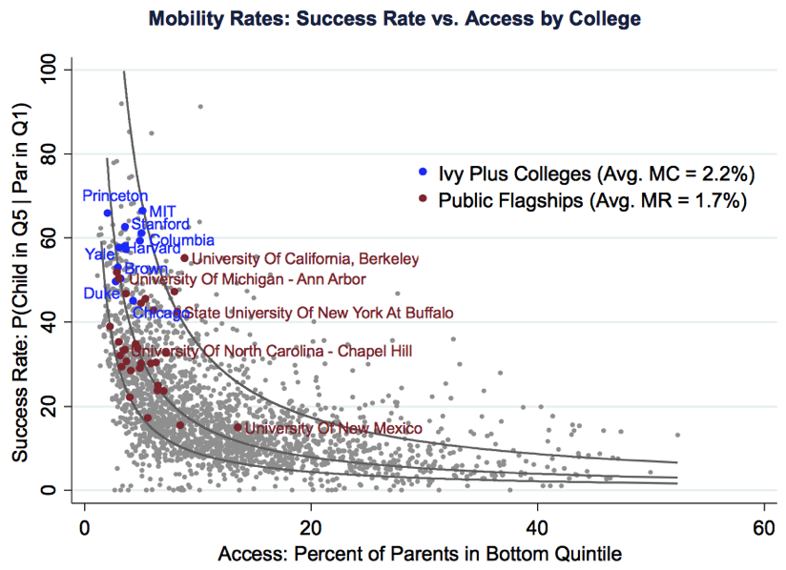

Slide 8
Annette Lareau 2003 Unequal Childhoods
Childrearing practice differences by social class
“Concerted cultivation” vs “Accomplishment of natural growth”
Extra curriculum activity/ management of time vs free play
Engagement with institutional authority figures
Sense of entitlement vs sense of constraint
Language use/logic
Institutional standards and expectations in modern society
Ten-year follow-up: differential educational and occupational attainment outcomes.
Methodology:
Interview: 88 African American and white families
Participant observation: 12

Slide 9
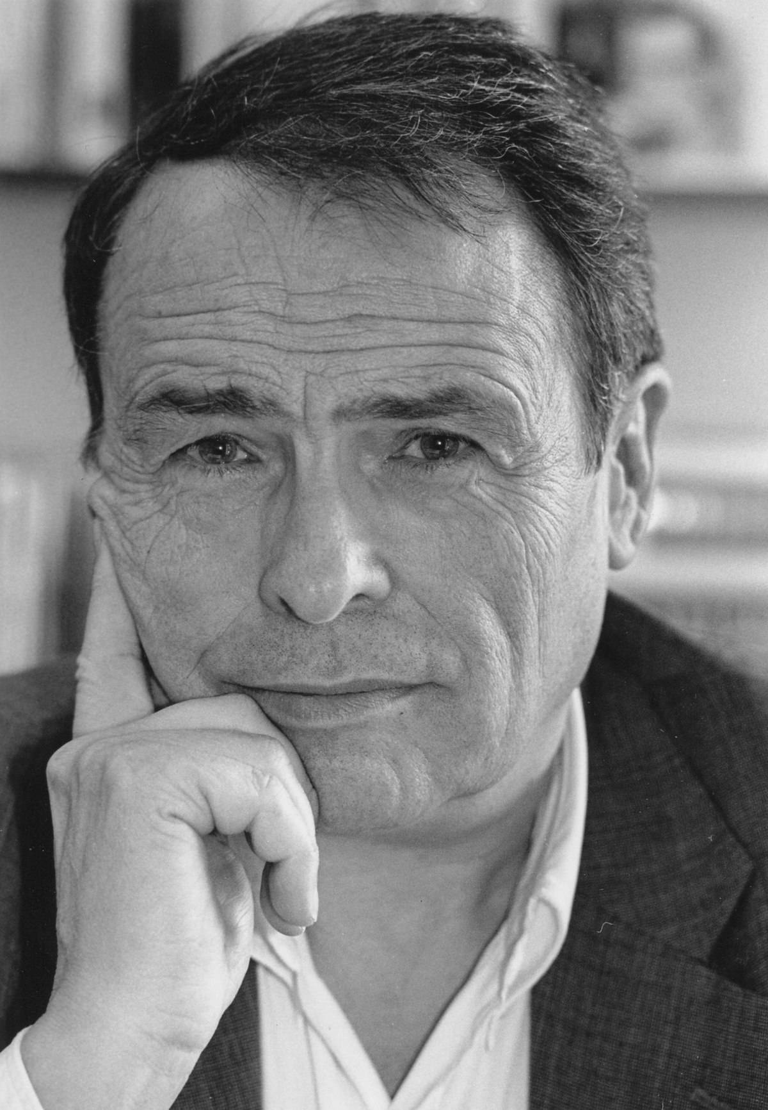
Cultural Capital and Pierre Bourdieu
Bourdieu, Pierre and Jean-Claude Passeron. 1977[1970]. Reproduction in Education, Society and Culture. Beverly Hills, CA: Sage.
Reproduction of educational attainment by family background (dominant vs subordinate class)
Legitimation
Lamont and Lareau (1988): institutionalized, i.e., widely shared, high status cultural signals (attitudes, preferences, formal knowledge, behaviors, goods and credentials) used for social and cultural exclusion
Pierre Bourdieu (French: [buʁdjø]; 1 August 1930 – 23 January 2002)
Notes:
Rugby player, difficult to master; books translated into English: more than 30 … Michael The most important sociologist of our time (1930-2002)

Slide 10

Distinction: A Social Critique of the Judgement of Taste (Bourdieu [1979] 1984)
Study of class distinction through the lens of culture in French society
Judgments of taste as related to social position and acts of social positioning
Empirical component: data from quantitative surveys, photographs and interviews
External social structures and subjective experience on the individual
Habitus: socially ingrained habits, skills and dispositions that shape the body and the mind; as a result, it shapes present social actions of an individual
“Forms of capital”

Slide 11
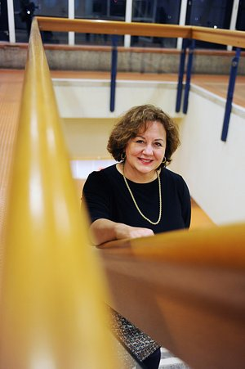
Michèle Lamont
Harvard faculty; leading cultural sociologist in the US; 108th President of American Sociological Association
Grew up in Quebec and pursued her PhD in Paris under the supervision of Bourdieu
Contributions to inequality studies, comparative sociology, and the sociology of knowledge and academia:
1987. “How to Become a Dominant French Philosopher: The Case of Jacques Derrida.” American Journal of Sociology, 93(3): 584-622.
1992. Money, Morals, and Manners: The Culture of the French and the American Upper-Middle Class. Chicago, IL: University of Chicago Press.
2009. How Professors Think: Inside the Curious World of Academic Judgment. Cambridge, MA: Harvard University Press.
Lamont, Michèle et al. 2016. Getting Respect: Responding to Stigma and Discrimination in the United States, Brazil, and Israel. Princeton, NJ: Princeton University Press.

Slide 12
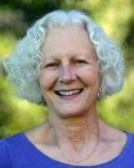
Ann Swidler, Culture in Action (1987)
Most highly cited paper in cultural sociology (12121 times by today)
Key question: Does culture “matter”—i.e., causally impact social action?
Critique: Culture as values that define the ends and goals of actions; Culture of poverty
Establish: Culture = tool kit for constructing strategies of action

Slide 13
p281
‘Such cultural influence can be observed in "cultural lag." People do not readily take ad- vantage of new structural opportunities which would require them to abandon established ways of life. This is not because they cling to cultural values, but because they are reluctant to abandon familiar strategies of action for which they have the cultural equipment.’

